Slide 1
Rx.AI Multimodal
Progress Update
Adaptive patient intake with text, voice, and camera interaction.
From static check-in forms to a working multimodal questionnaire flow.

Slide 2
What We Built So Far
Backend
Voice
Camera / UI
Added adaptive questionnaire generation flow
Built backend routing for multimodal interactions
Added endpoints for speech-to-text, image analysis, and question generation
Integrated voice mode into the questionnaire flow
Added recording and repeat-question behavior
Added low-confidence transcription handling and editable transcript support
Added multimodal questionnaire UI updates
Added patient portal questionnaire release and access flow
Added text-only and voice-plus-camera interaction modes

Slide 3
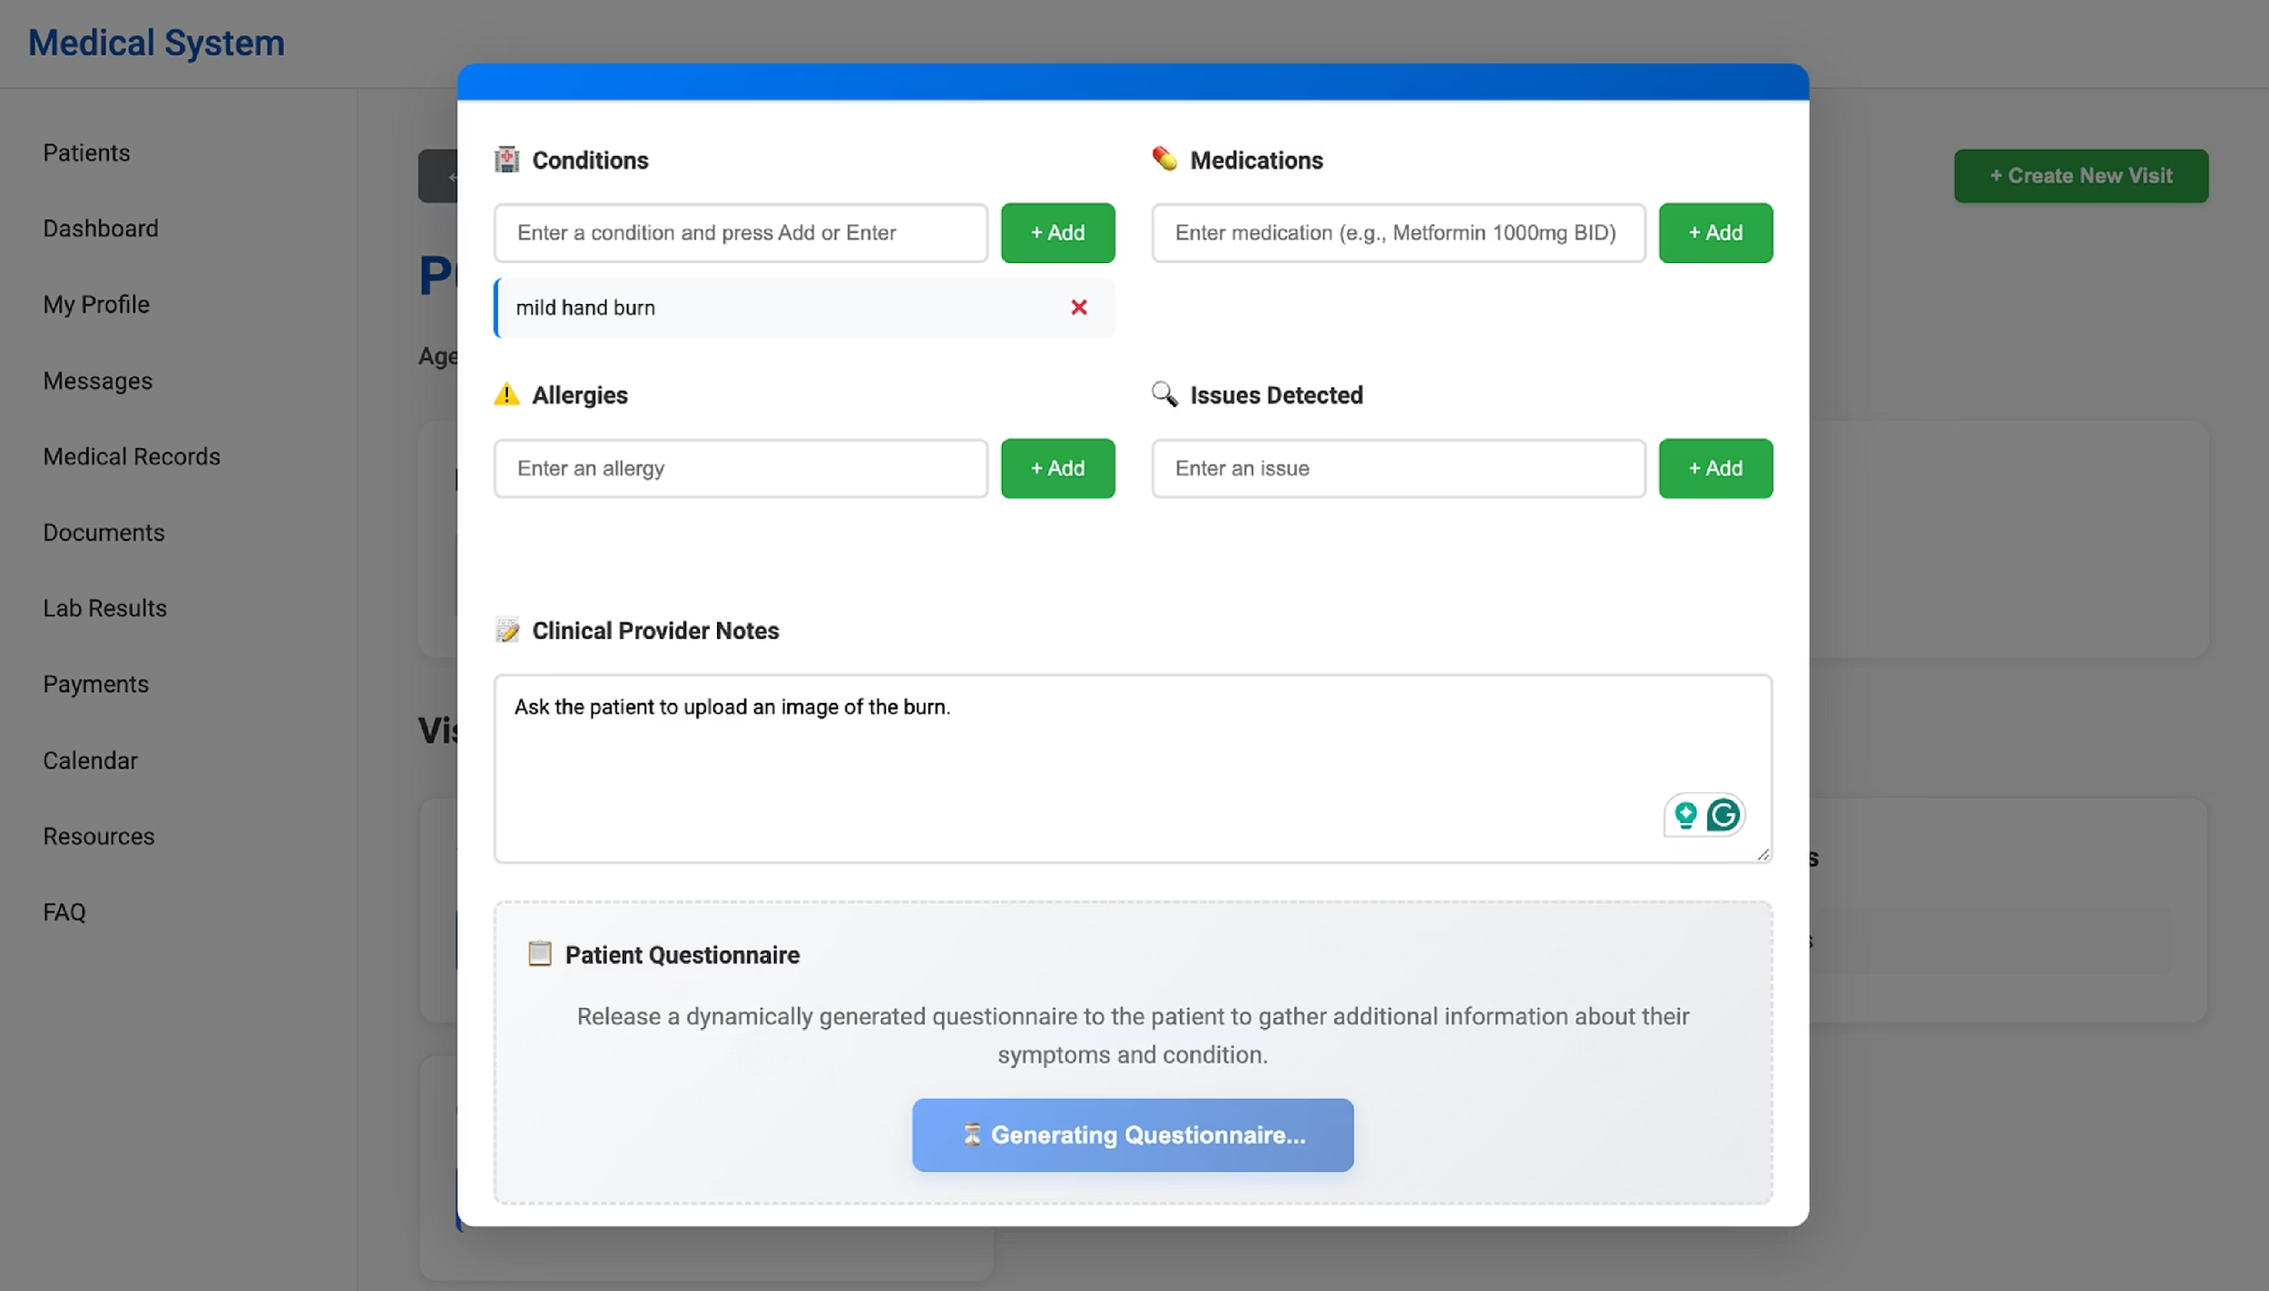
UI Progress: Provider Side Flow

Slide 4
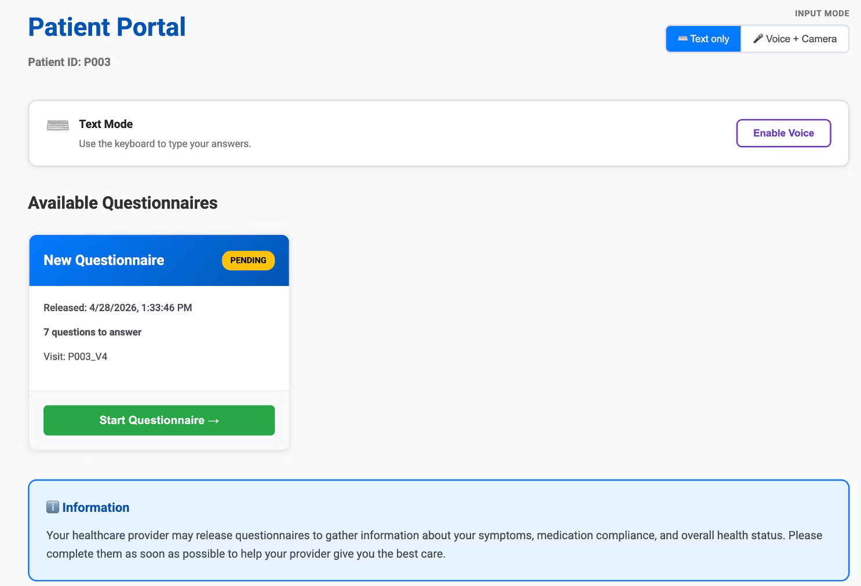
UI Progress: Patient Portal & Questionnaire
Patient portal: Released questionnaires now appear in the patient portal with visit and progress information.

Slide 5
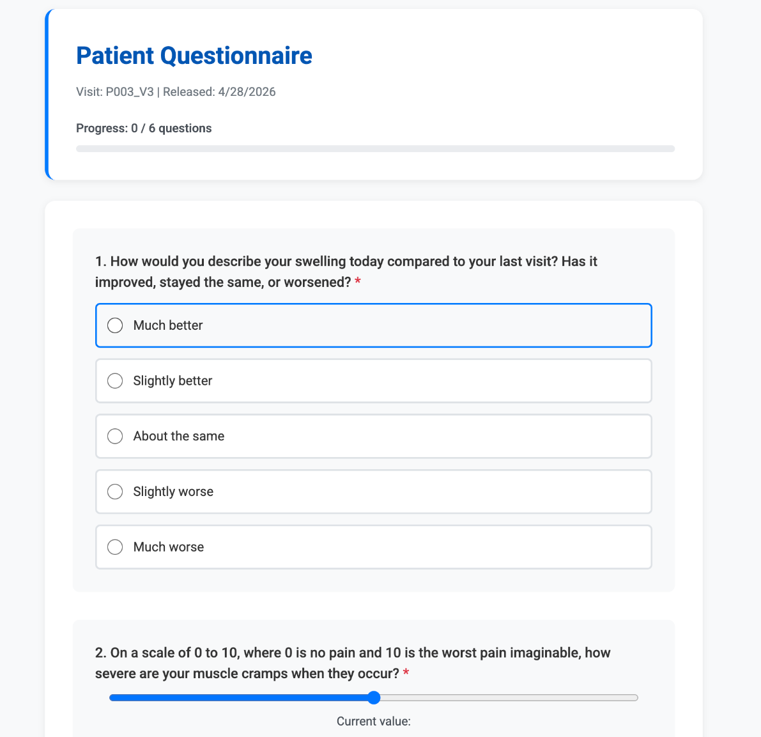
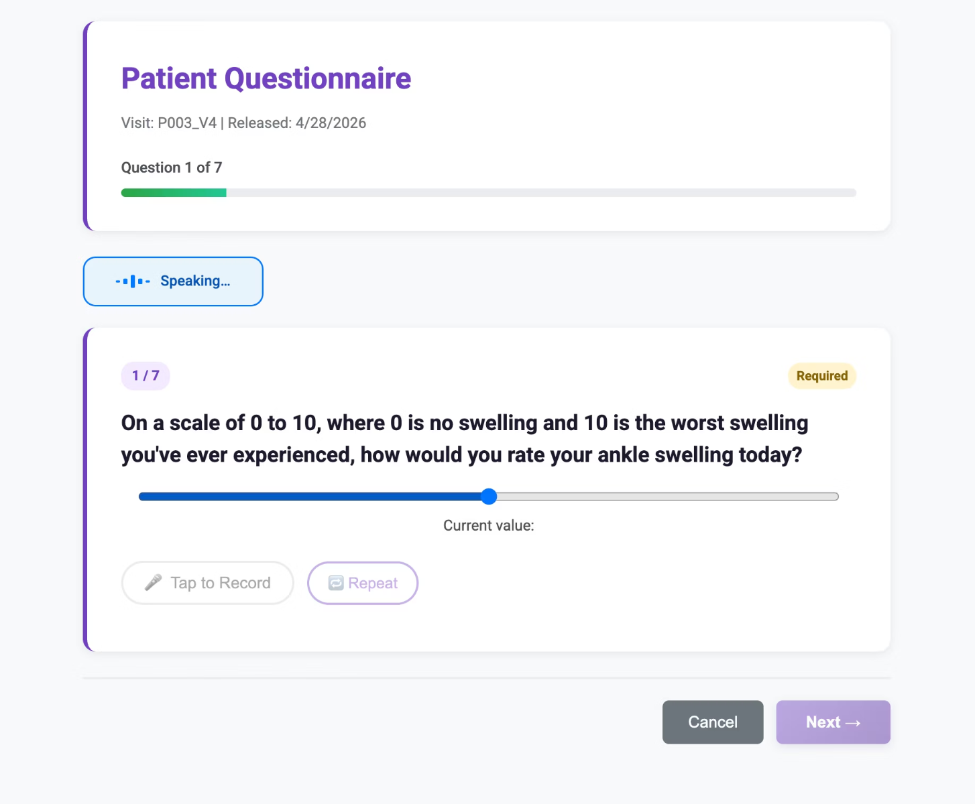
UI Progress: Patient Portal & Questionnaire
Questionnaire experience: Patients can answer through the updated questionnaire interface with progress tracking and voice controls.

Slide 6





Working End-to-End Flow
Provider creates a new visit and enters patient condition context.
System generates a dynamic questionnaire based on the visit.
Questionnaire is released to the patient portal.
Patient opens the questionnaire and answers through text, voice or images.
The intake process becomes more adaptive and structured than a fixed form.

Slide 7
Next Steps
01
02
03
Polish
Testing
Reliability
Polish the user experience and edge cases.
Expand testing across text, voice, and multimodal flows.
Improve reliability for speech transcription and interaction handling.
04
05
Demo
Submission
Finalize demo scenarios and presentation materials.
Prepare the system for final walkthrough and submission.

